Slide 1
Project Management
Project Cost Management

Slide 2

About Project Costs
Estimating
What do we
expect it to cost?
Expenses
Controlling
Budgeting
How will we manage
variances between
our plan & actual?
How much will we
spend and when
will we spend it?

Slide 3
(Some) Sources of Project Costs
Materials
Sub-contracted
Work
Labor
Work Package
Costs
Equipment
Lease
Services
Overhead
Tools &
Supplies

Slide 4
Types of Project Costs
Direct
Indirect
Labor
Materials
Contracts
Support
Benefits
Overhead
Admin
Total
Project
Costs
+
=
Costs related to a project that can be traced back to a cost effective way
Costs related to a project that CANNOT be traced back to a cost effective way

Slide 5
Function of the Budget
Document - lists planned expenditures
Serves as a standard for comparison
It is a baseline for financial project performance
Budgeting procedures – link resource use to achievement of organizational goals
The budget – the money side of the project plan – approved at conclusion of the planning phase

Slide 6
Example of Computing the Different Project Costs

Slide 7
Project Inertial Guidance System
Labor is estimated to be 1202 hours at $45/hour
Materials and supplies $2,100
Clean-up services $200
Contract – computer rental $450
Cost loading requirements: labor (.87), Materials (.09), Services (.57), Contracts (.17)
Profit requirement is 24%

Slide 8
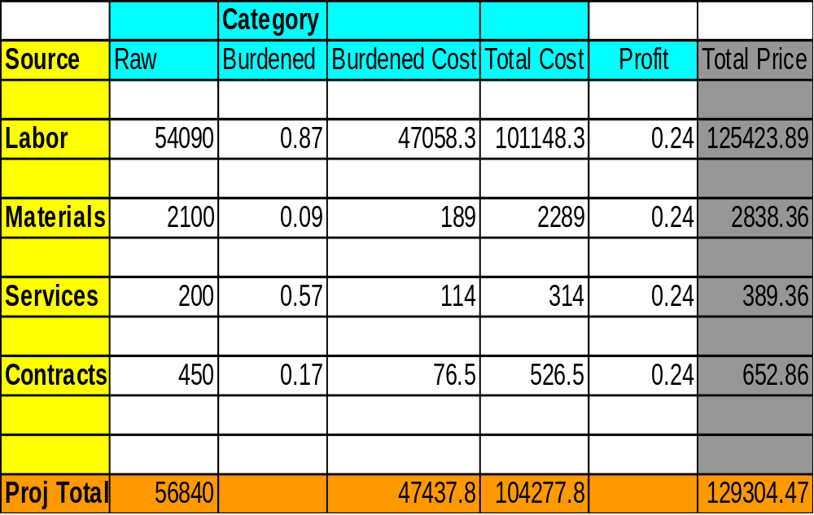
Inertial Guidance System Costs

Slide 9
Project Time-Phased Budget
Costs related to activities (work packages) and associated resources throughout the Project Life Cycle
Based on:
  Activity cost estimates (all costs)
  WBS – timing of costs
  Manpower plan (wages & labor costs)
Activity costs divided into reporting periods

Slide 10
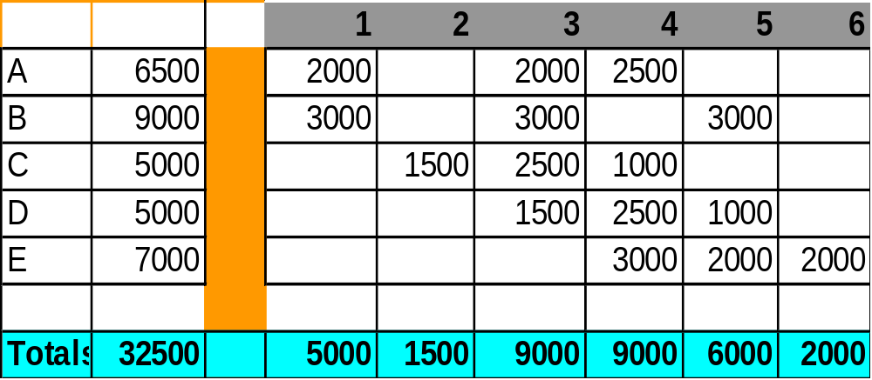
Time-Phased Project Budget
Activity
Time Period (Months)
Cost

Slide 11
Controlling the Project:
Computing for the EVA

Slide 12
Critique…
  My project budget is $500, and I’ve already spent $400, I can therefore conclude that my project is 4/5 done!

Slide 13

What’s the Project Status?
10 Computers to upgrade
1,000 man-hours budget
4 weeks to complete (i.e, 250 man-hrs/week)
End of wk. 2. Have used 600 man-hours.
How’s the Project?

Slide 14
What’s the Project Status?
10 Computers to upgrade
1,000 man-hours
4 weeks to complete (i.e, 250 man-hrs/week)
End of wk. 2 Have used 600 man-hours and.....
4 installed in 1st two wks.
How’s the Project?
What’s the% complete? 4 units/10 units = 40% or 2 wk/4 wk. = 50% or 600hr/1000hr = 60%
Earned value is a great way to summarize the work completed in “Dollarized” terms.
Especially useful on multi-task projects

Slide 15
Need for Earned Value
Example – % project completion:
  Budgeted $500
  Spent $400
  What is the project completing percentage?
Earned value – a set of aggregate performance measures
The Problem – Expenditures to budget doesn’t consider AMOUNT OF WORK DONE!!

Slide 16

Earned Value Analysis (EVA)
EVA is a project performance measurement technique that integrates scope, time, and cost data
Compares “actuals” to “baseline”
Actuals: how much of a WBS item has been completed
Given a baseline (original plan plus approved changes), you can determine how well the project is meeting its goals
You must enter actual information periodically to use EVA

Slide 17
A note though…
  Earned Value only identifies difference
    Says nothing about “source” or “cause” for variance
    Says nothing about “correction” of
    variance

Slide 18
EVA
- The Variables -
EV or BCWP – Earned Value
  “Percentage of work actually completed multiplied by the Planned Value.”
  “How much work was done?”
AC or ACWP - Actual Cost
  “Total direct & indirect costs incurred in accomplishing work on an activity during a given period of time.”
  “Burned”
  “How much did it cost?”

Slide 19
EVA
- The Variables -
PV or BCWS – Planned Value
  “That portion of the approved total cost estimate planned to be spent on an activity during a given period.”
  “How much work should be done?”

Slide 20

Performance Measures
CV (cost variance)
= EV - AC (budgeted cost - actual cost)
= BCWP - ACWP
SV (schedule variance)
= EV – PV (earned value – planned value)
(cost of work performed -cost of work scheduled)
BCWP - BCWS
    For both cases, negatives are termed ‘unfavorable’
    Can be plotted on ‘spending curves’
      Cumulative cost (Y axis) vs. Time (X axis)
      Typically in an ‘S’ shape

Slide 21
The Real Picture?
10 Computers
1,000 man-hours
4 weeks to complete (i.e, 250 man-hrs/week)
End of wk 2. Have used 600 man-hours and.....
4 upgraded in 1st 2 wks Earned Value=4*100 BCWP=400
Cost variance 400-600= -200 manhrs
  Project is over budget
Schedule Variance 400-500 = -100 manhrs
  Project is behind schedule
Comparison of work planned vs work “Earned” gives a True Picture of Project Status

Slide 22
Performance Measures
CPI (cost performance index)
= EV / AC
=BCWP/ACWP
SPI (schedule performance index)
= EV / PV
=BCWP/BCWS
used to re-estimate time to completion
There are problems in the project if any one of these is less than 1 (or 100%)
CR: Critical Ratio
  SPI x CPI
  1: everything on track
  > .9 and < 1.2 ok

Slide 23
What’s the Project Status?
10 Computers to upgrade
1,000 man-hours
4 weeks to complete (i.e, 250 man-hrs/week)
End of wk.. 2 have used 600 man-hours and.....
4 upgraded in 1st 2 wks BCWP=4*100=400
Cost Performance Index BCWP/ACWP 400/600=.66
For each dollar we planned to spend, we only accomplished $.66 dollars of work
Schedule Performance Index BCWP/BCWS 400/500=.80
For each hour we worked, we only accomplished 80% of what we had planned.

Slide 24
Other Derived Values
BAC: Budget At Completion
  Sum of all budges (BCWS). Your original budget.
EAC: Estimate At Completion
  Forecast total cost at completion
  EAC = ((BAC – BCWP)/CPI) + ACWP
  Unfinished work divided by CPI added to sunk cost
  If CPI < 1, EAC will be > BAC

Slide 25
Other Derived Values
To Complete Performance Index (TCPI)
  TCPI = (BAC - BCWP)/(BAC - ACWP)
  Denotes the amount of performance required for the remaining work of the project in order to get the project back on track if things don’t change
Should be kept as close as possible to 1.00

Slide 26
Other Derived Values
Variance at Completion (VAC)
  VAC = (BAC - EAC)
  Denotes the amount over or under what was budgeted for the project
Work Accomplished (%)
  BCWP/BAC
Budget Spent (%)
  ACWP/BAC

Slide 27
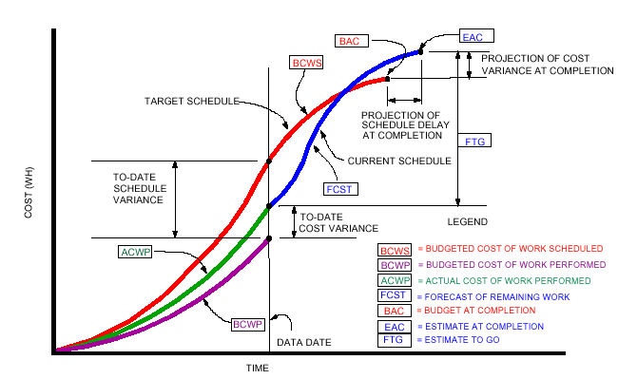
Earned Value Analysis

Slide 28
Variance Analysis
Variance: “Any schedule, technical performance, or cost deviation from a specific plan.”
Used at all levels of project management
Two “threads”:
  Budgeting System
  Scheduling System
Variance Analysis helps identify the causes of an actual outcome deviating from its forecast
. . . a primary Project Manager’s responsibility!!

Slide 29
EVA Rules of Thumb
Negative numbers for cost and schedule variance indicate problems. The project is costing more than planned or taking longer than planned
CPI or SPI less than 100% indicate problems
The Problem: The Project is costing more than planned a/o taking longer than planned

Slide 30
EVA Rules of Thumb
- Another View -
If CPI = 1.0 (100%), we have perfect performance
If CPI > 1.0 (100%), we have exceptional performance
If CPI < 1.0 (100%), we have poor performance
The same analysis can be applied to the SPI

Slide 31

Variance Analysis Questions
What is the problem causing the
  variance?
What is the impact on time, cost, & performance
What is the impact on other efforts, if any?
What corrective action is planned or under way?
What are the expected results of the corrective action?

Slide 32
Exercise in Earned Value Analysis

Slide 33
Earned Value Exercise 1
A 15 week project has been initiated. The budget for the project is $460,000. Here is the data for 3 weeks of the project. The scheduled work was 21 days, it has taken 23 days.
Week
BCWS
BCWP
ACWP
1
$35K
$31K
$26K
2
$25K
$24K
$18K
3
$30K
$25K
$23K

Slide 34
How are we doing?
Compute for all the EV ratios.
Based on the EV ratios, we ask : What are our options?
  borrowing resources
  Investigating
  Reallocation of resources
  Adding resources (overtime, resources)
  Negotiating for modification of C, T, S, P with customer

Slide 35
Acting on EV Information
Take note: Performance Indicators don’t tell the story, make decisions, or take action
When we have a cost overrun or performance underrun, the PM should ask “Why? What must we do to get the system back on target?”

Slide 36
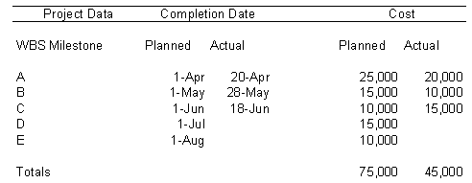
EVA Exercise 2
As of 1-July where are we?
BCWS BCWP ACWP

Slide 37
EVA Exercise 2
What are the values of these measures?
CV SV CPI
SPI CR

Slide 38
Earned Value Analysis
Benefits
  Consistent unit of measure for total progress
  Consistent methodology
    Across cost and completed activity
    Apples and apples comparisons
  Ability to forecast cost & schedule
  Can provide warnings early
Success factors
  A full WBS is required (all scope)
  Beware of GIGO: Garbage-in, garbage-out

